Slide 1

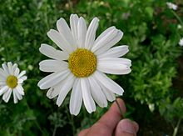
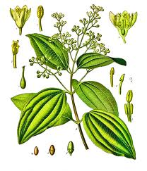
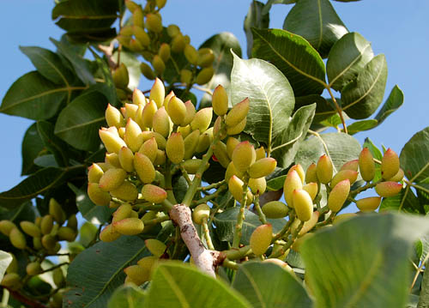
Tanacetum cinerariifolium
Vanilla flower
SECTION VI (CHAP 20)
ALDEHYDES AND KETONES
Cinnamomum verum
Pistacia vera

Slide 2
FUNDAMENTAL CONCEPTS
Nomenclature of aldehydes and ketones
Synthesis of aldehydes and ketones
Wittig reaction
Acetal protection of carbonyls
Addition of HCN
Imines formation
Oxidation of aldehydes
Deoxygenation of carbonyls
Bayer-Villiger reaction

Slide 3
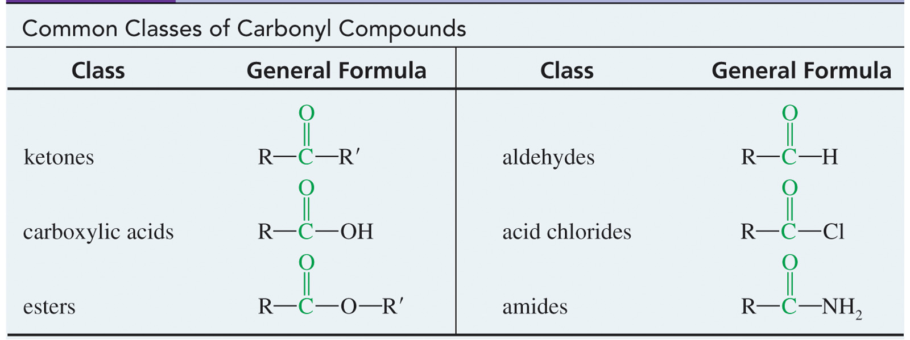
CARBONYL COMPOUNDS
They are compounds containing the carbonyl group (C=O) in their structure. The simplest carbonyl compounds are ketones and aldehydes.
Ketones haves two alkyl (or aryl) groups bonded to the carbonyl carbon, while aldehydes have one alkyl (or aryl) group and one hydrogen atom bonded to the carbonyl carbon.

Slide 4
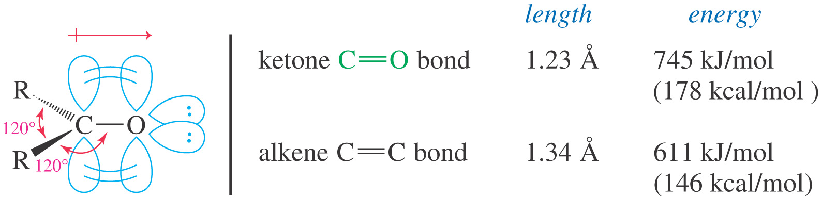
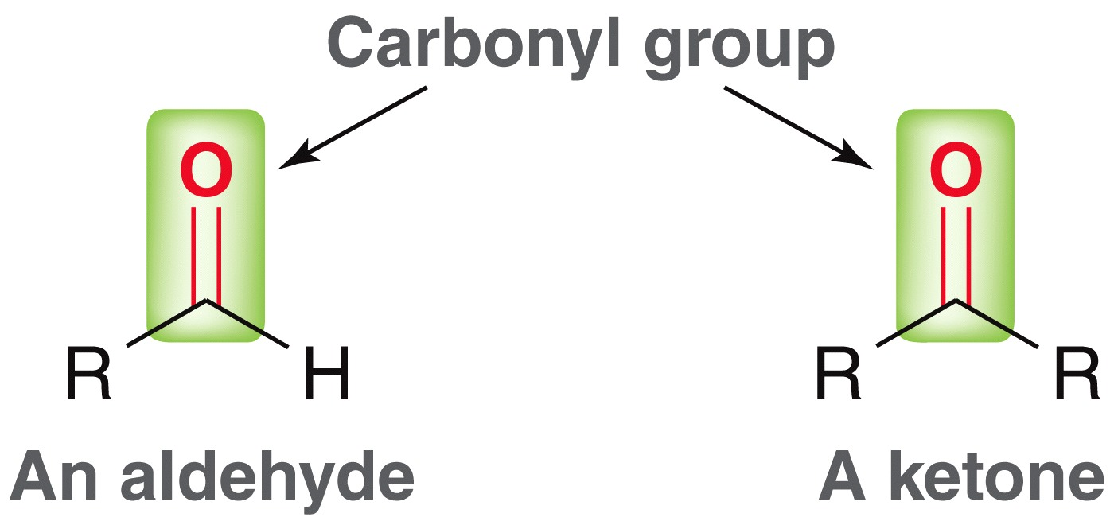
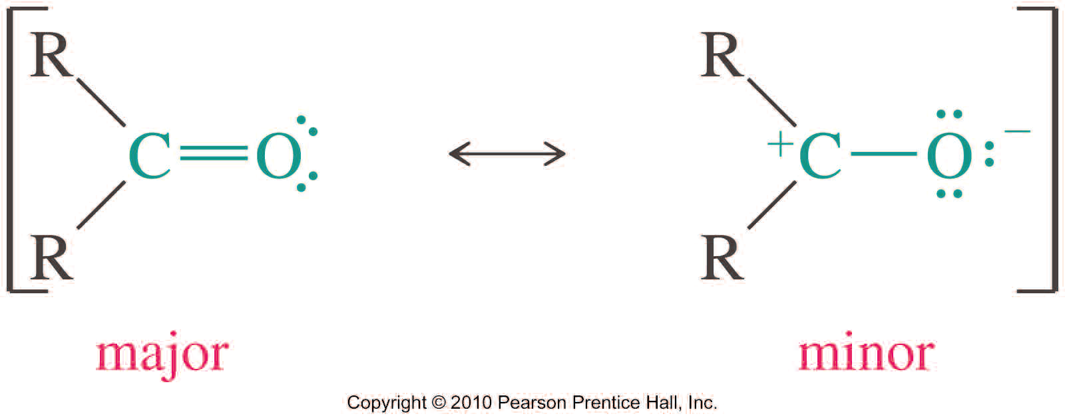
CARBONYL COMPOUNDS
Carbonyl Structure
The carbonyl carbon is sp² hybridized carbon bonded to three other atoms through coplanar sigma bonds oriented about 120° apart.
C=O bond is shorter, stronger, and more polar than C=C bond in alkenes

Slide 5
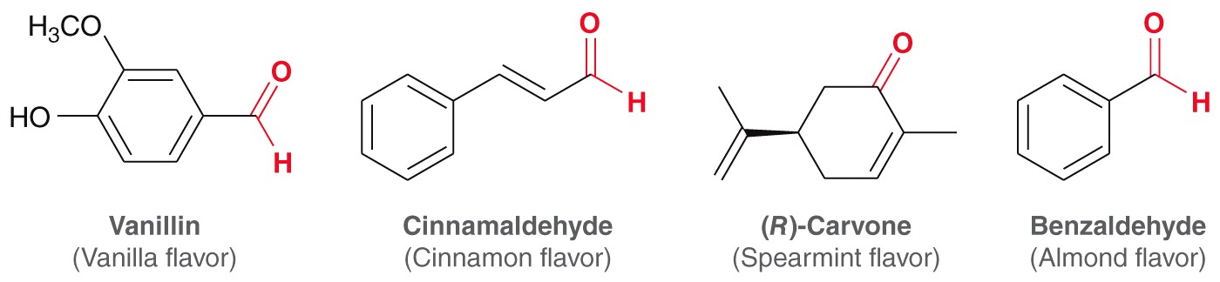
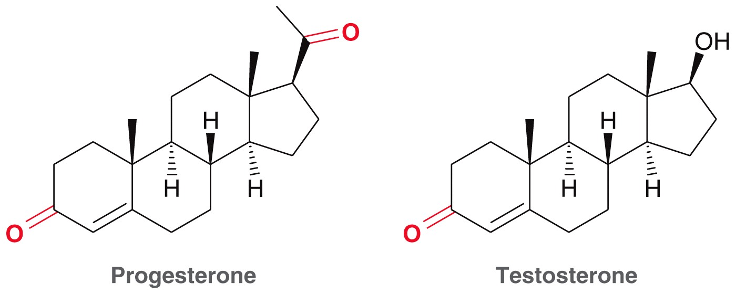
ALDEHYDES AND KETONES
Artificial Butter Flavoring and Certain Components, Diacetyl and Acetoin
Bronchiolitis obliterans also called obliterative bronchiolitis or constrictive bronchiolitis (or popcorn lung) is a rare and life-threatening form of non-reversible obstructive lung disease in which the bronchioles (small airway branches) are compressed and narrowed by fibrosis (scar tissue) and/or inflammation.
The compound is thought to react with N-α-acetyl-L-arginine to produce diacetyyl-arginine adducts.

Slide 6
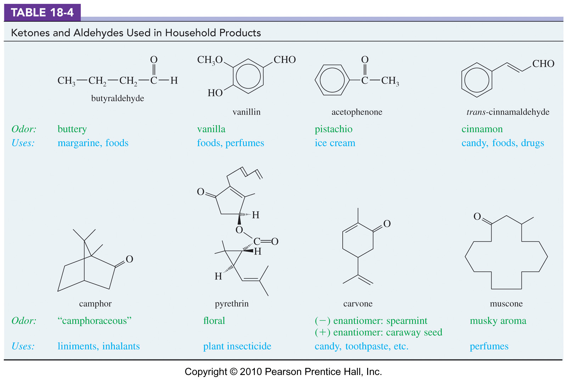
ALDEHYDES AND KETONES
Acetone and methyl ethyl ketone are important solvents.
Formaldehyde used in polymers like Bakelite®. (thermosetting phenol formaldehyde resin polyoxybenzylmethylenglycolanhydride)
Flavorings and additives like vanilla, cinnamon, artificial butter

Slide 7
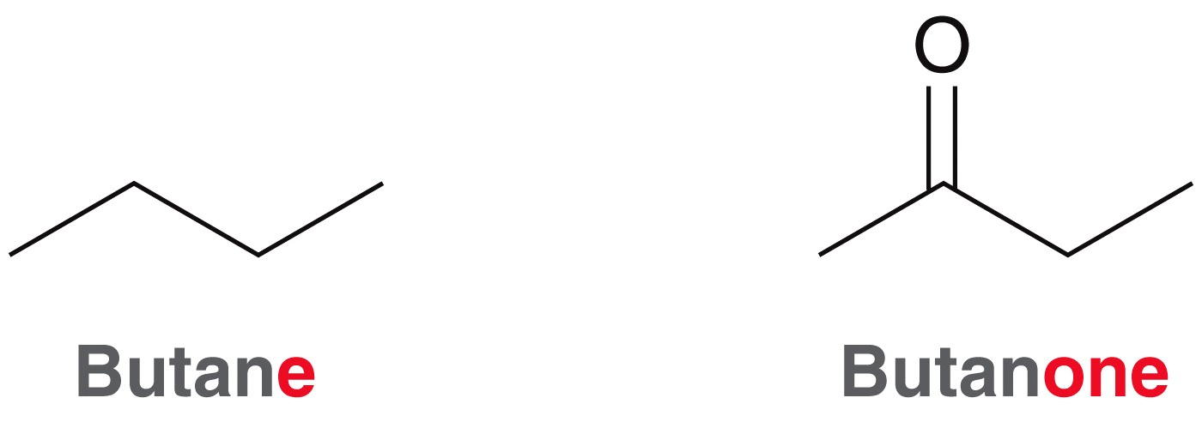
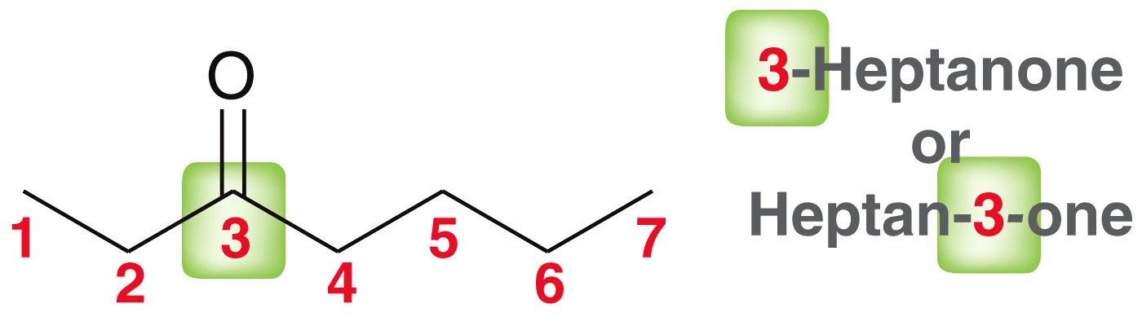
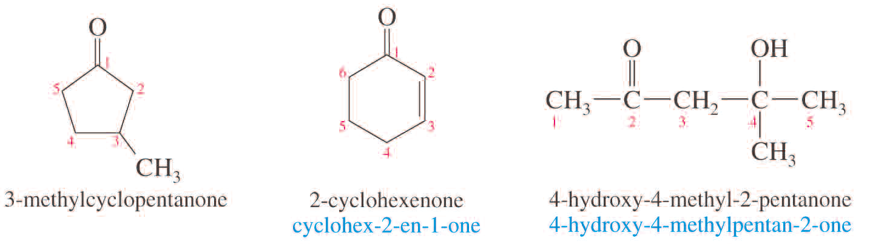
NOMENCLATURE OF KETONES
IUPAC Names for Ketones
Replace -e with -one. Indicate the position of the carbonyl with a number.
Number the chain so that carbonyl carbon has the lowest number.
For cyclic ketones the carbonyl carbon is assigned the number 1

Slide 8
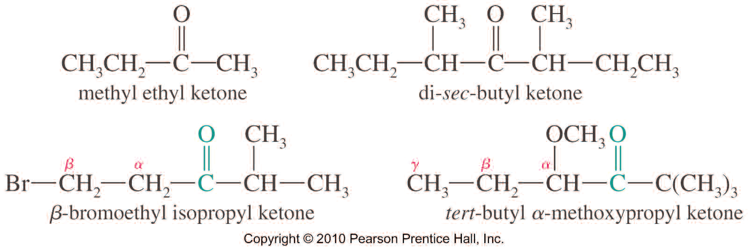
NOMENCLATURE OF KETONES
Common Names for Ketones
Named as alkyl attachments to -C=O. Using Greek letters instead of numbers to indicate the position of a substituent on the principal chain.
Historical Common Names

Slide 9
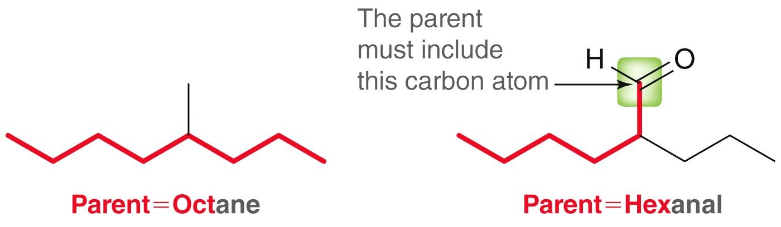
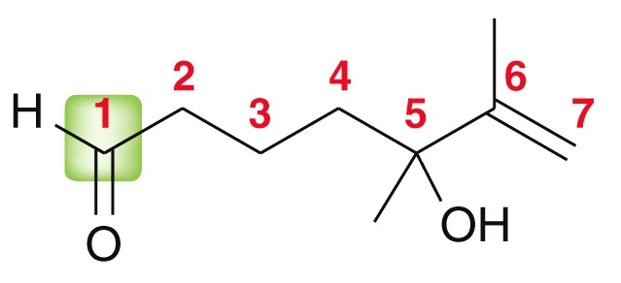
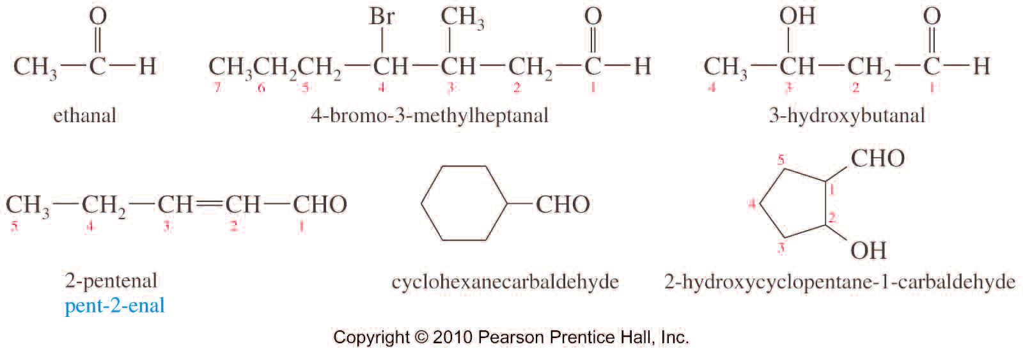
NOMENCLATURE OF ALDEHYDES
Naming Aldehydes
IUPAC: Replace -e with -al.
The aldehyde carbon is number 1.
If -CHO is attached to a ring, use the suffix –carbaldehyde
Aldehyde priority is higher than ketone

Slide 10
NOMENCLATURE OF ALDEHYDES
Name as Substituent
On a molecule with a higher priority functional group, C=O is oxo- and -CHO is formyl.
Examples: Name the following compounds
Practice 20.1 to 20.4 P. 935
Problems 20.44 to 20.49 P. 978

Slide 11
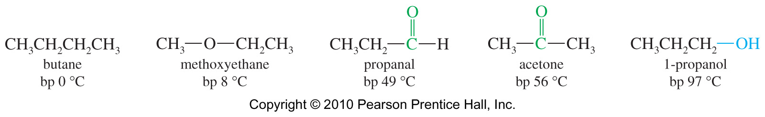
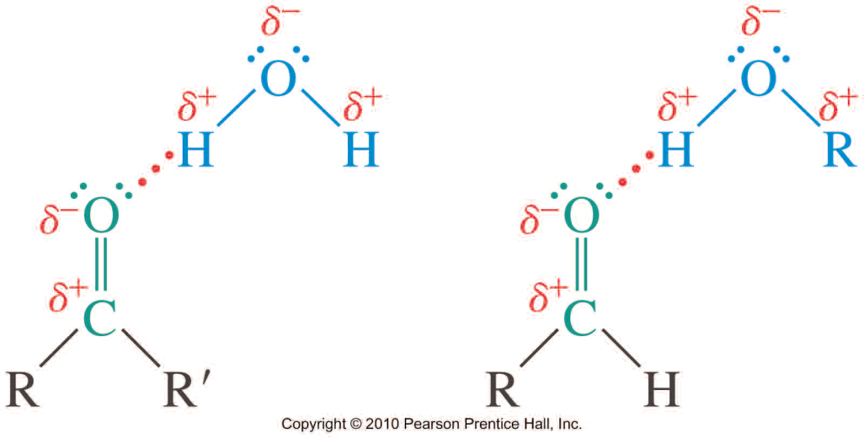
PHYSICAL PROPERTIES
Boiling Points
Aldehydes and ketones are more polar than similar alkane, so higher boiling point than comparable alkane or ether. But, they cannot form H-bond with each other, so lower boiling point than comparable alcohol
Solubility
Good solvent for alcohols.
Lone pair of electrons on oxygen of carbonyl can accept a hydrogen bond from O-H or N-H.
Acetone and acetaldehyde are miscible in water

Slide 12
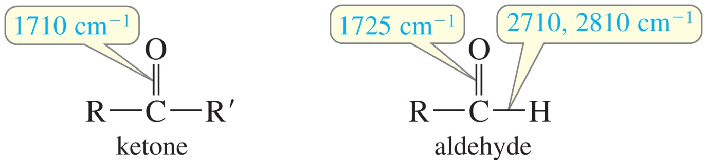
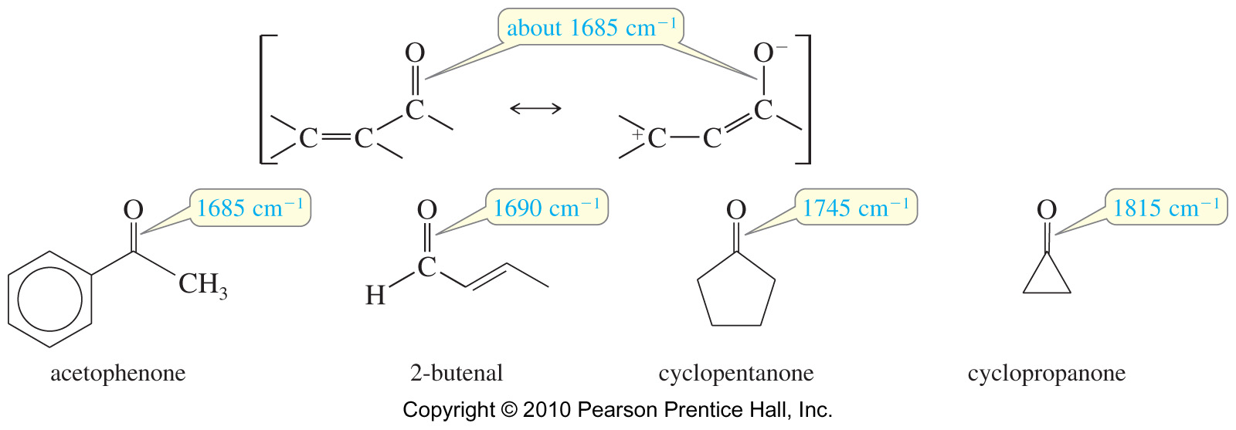
SPECTROSCOPY
IR Spectroscopy
Very strong C═O stretch around 1710 cm⁻¹.
Additional C—H stretches for aldehyde: Two absorptions at 2710 cm⁻¹ and 2810 cm⁻¹
Very strong C=O stretch around 1710 cm⁻¹.
Conjugation lowers frequency. Ring strain raises frequency.
But-2-enal

Slide 13
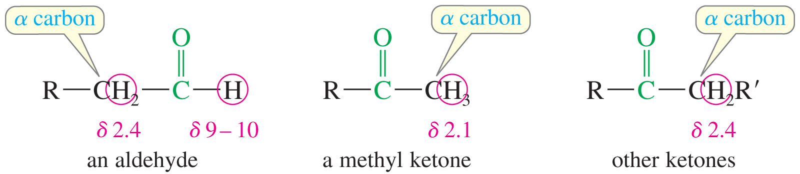
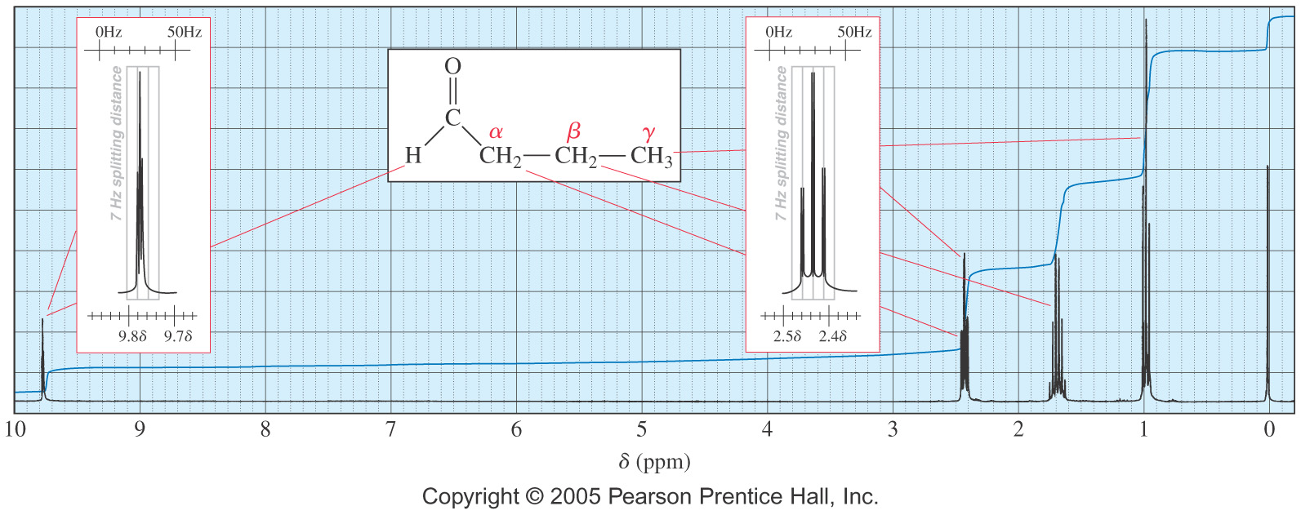
SPECTROSCOPY
¹H NMR Spectroscopy

Slide 14
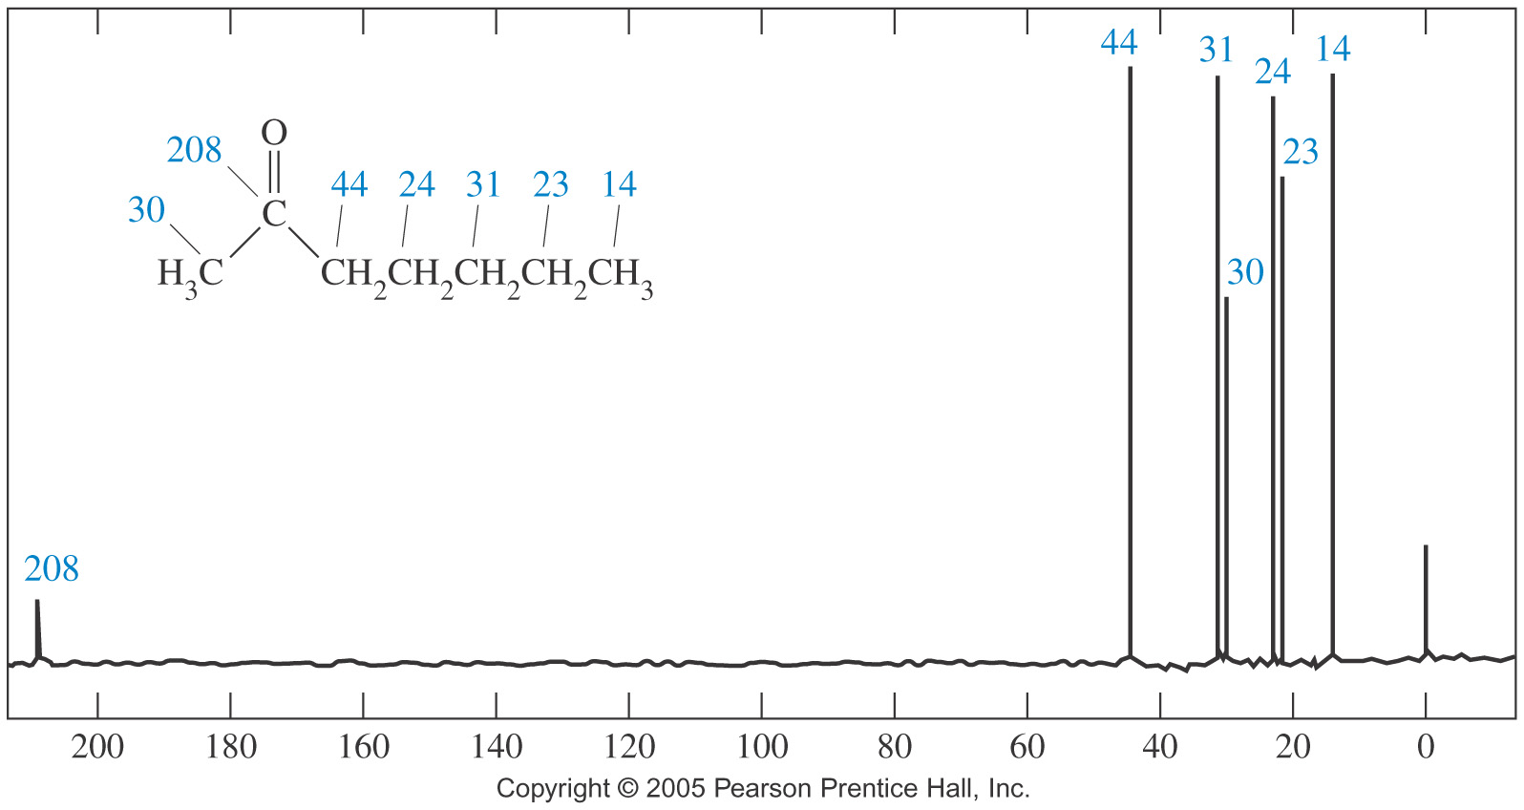
SPECTROSCOPY
¹³C NMR Spectroscopy
The spin-decoupled carbon NMR spectrum of 2-heptanone shows the carbonyl carbon at 208 ppm and the α carbon at 30 ppm (methyl) and 44 ppm (methylene).

Slide 15
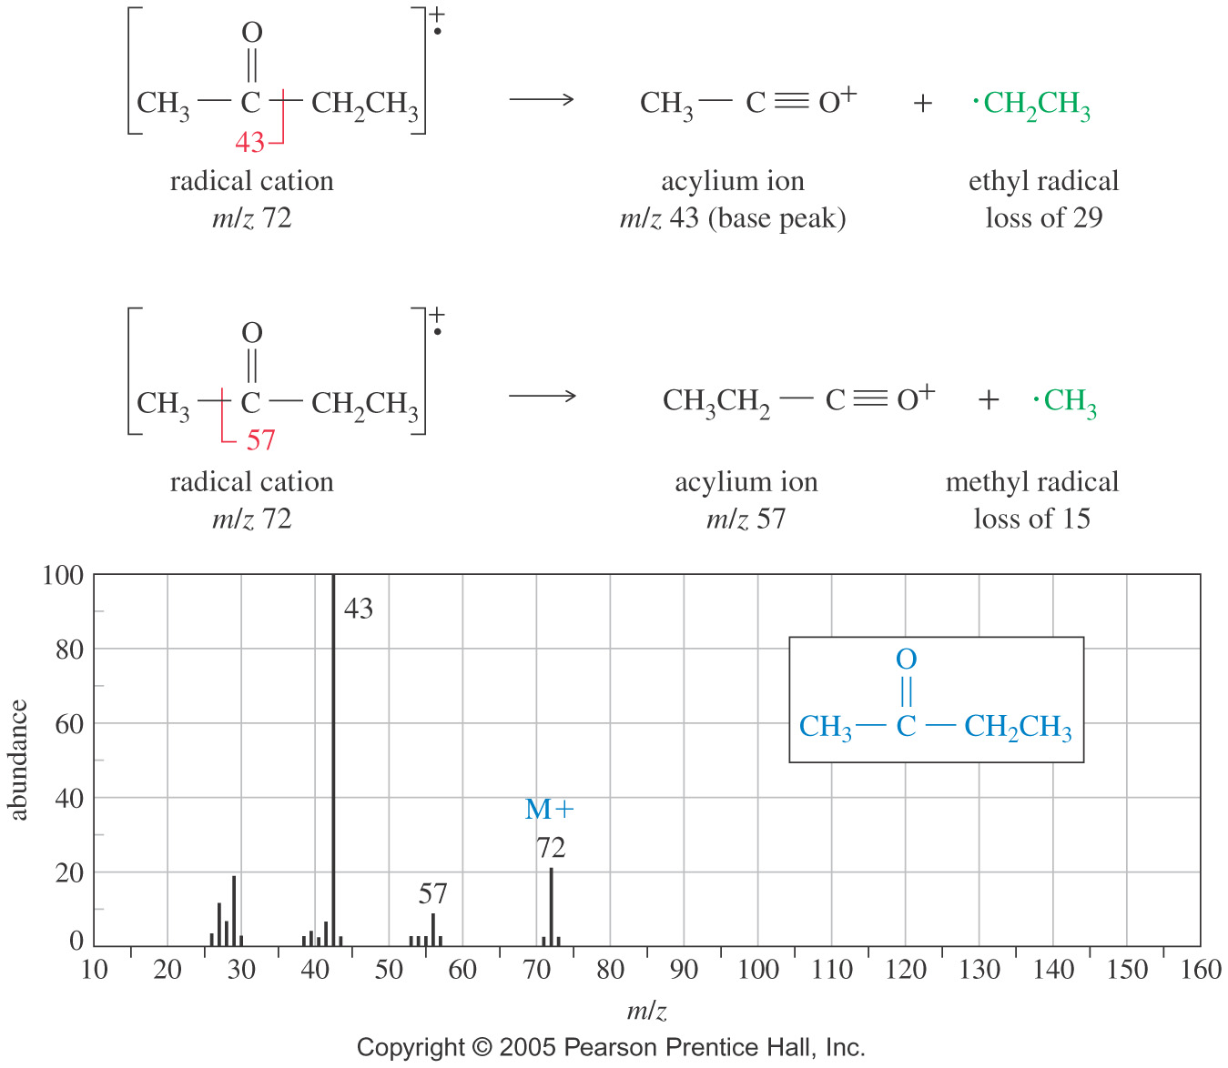
SPECTROSCOPY
MS for Butan-2-one

Slide 16
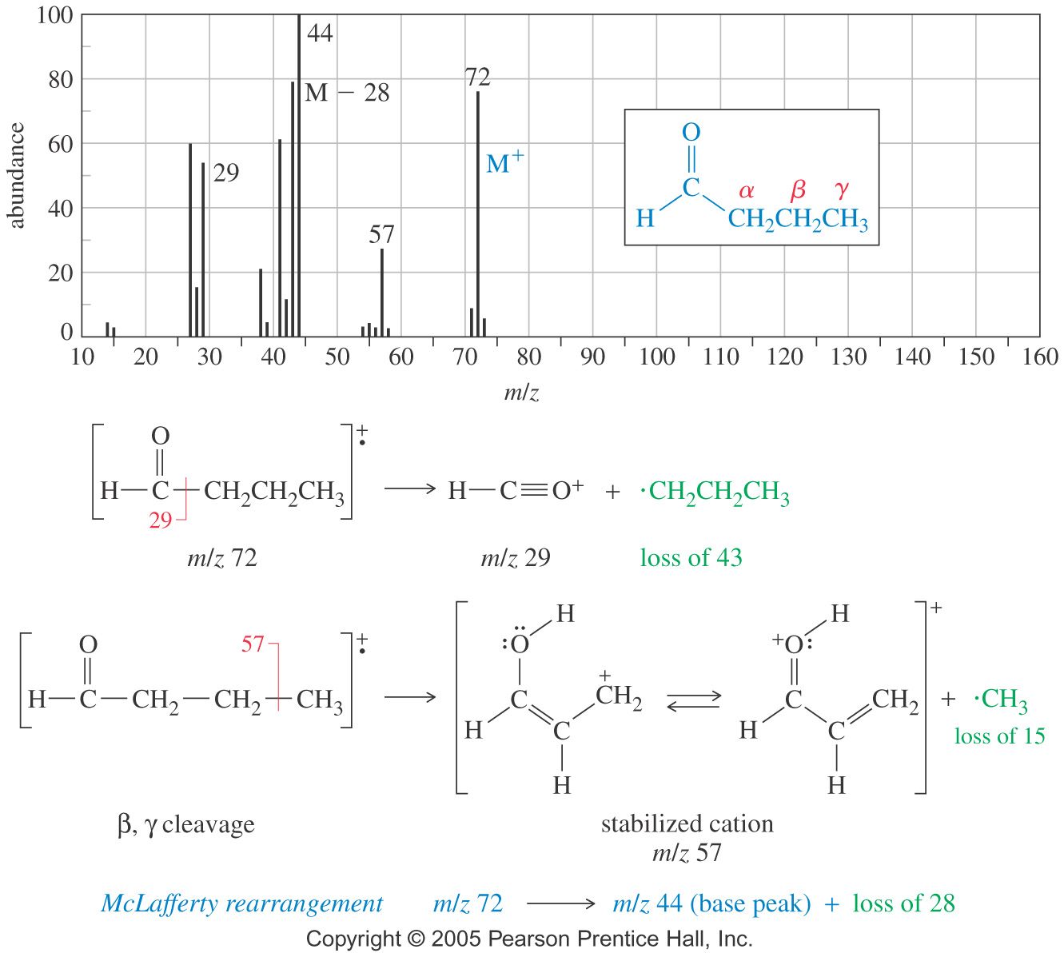
SPECTROSCOPY
MS for Butyraldehyde

Slide 17
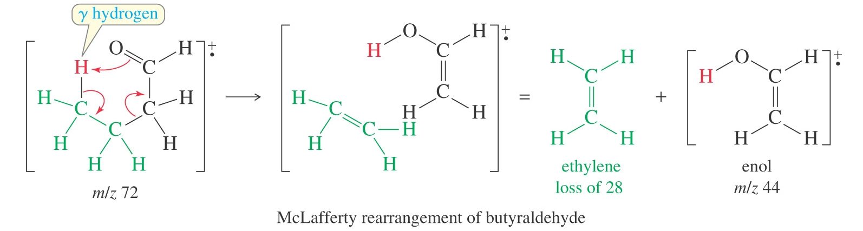
SPECTROSCOPY
MS for Butyraldehyde: McLafferty Rearrangement
The net result of this rearrangement is the breaking of the α, β bond, and the transfer of a proton from the γ carbon to the oxygen.
An alkene is formed as a product of this rearrangement through the tautomerization of the enol

Slide 18
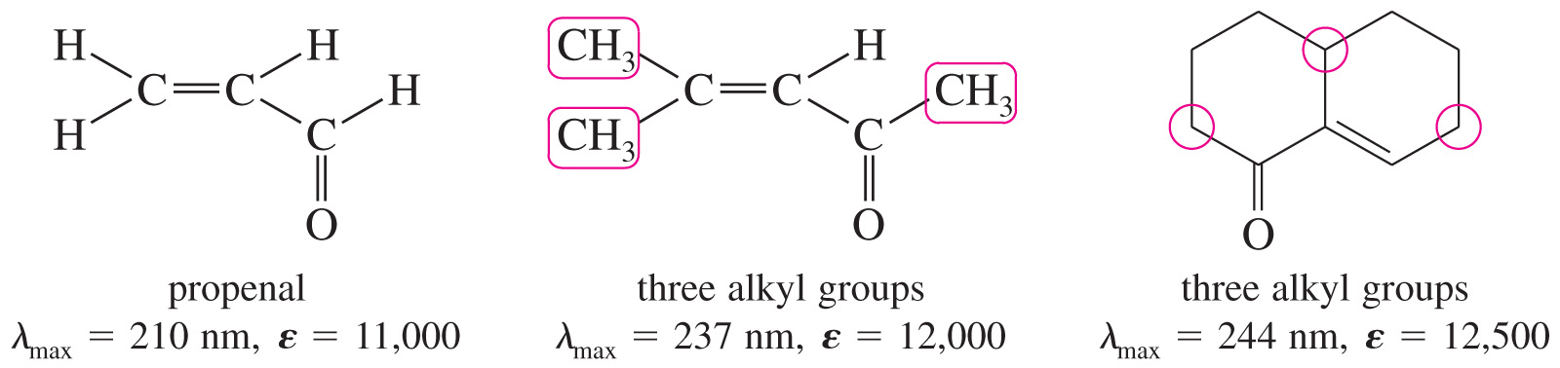
SPECTROSCOPY
Ultraviolet Spectra of Conjugated Carbonyl Compounds
Conjugated carbonyl compounds have characteristic π -π* absorption in the UV spectrum.
An additional conjugated C═C increases λ_{max} about 30 nm; an additional alkyl group increases it about 10 nm.

Slide 19
SYNTHESIS OF ALDEHYDES AND KETONES
Synthesis Review
Oxidation
2° alcohol + Na₂Cr₂O₇ (or PCC) → ketone
1° alcohol + PCC → aldehyde

Slide 20
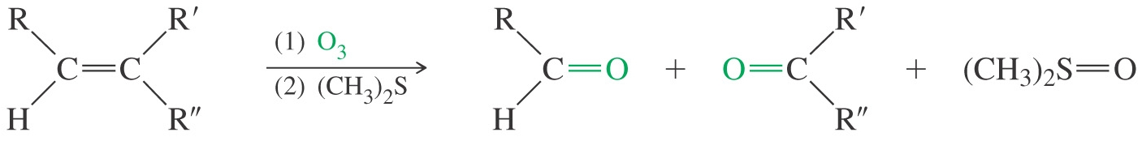
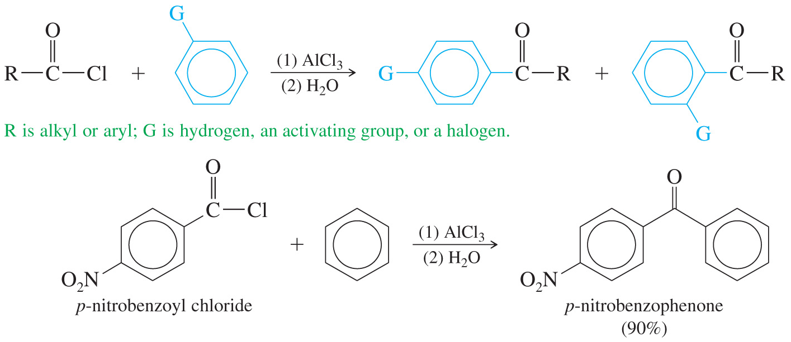
SYNTHESIS OF ALDEHYDES AND KETONES
Synthesis Review
Ozonolysis of alkenes
Friedel–Crafts Reaction

Slide 21
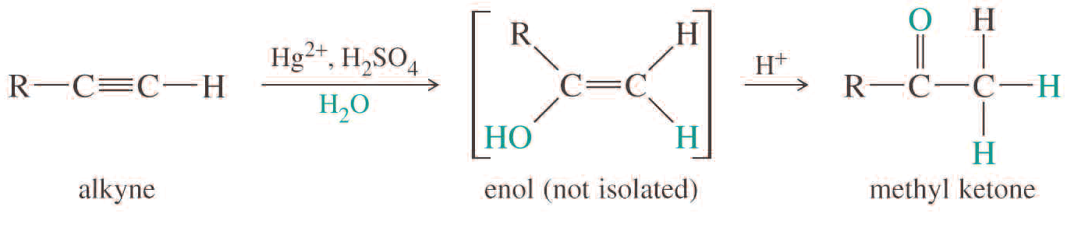
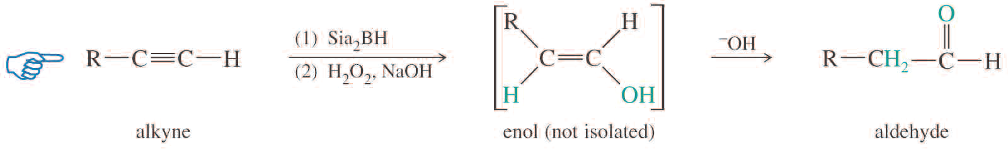
SYNTHESIS OF ALDEHYDES AND KETONES
Synthesis Review
Hydration of terminal alkyne
Use HgSO₄, H₂SO₄, H₂O for methyl ketone
Use Sia₂BH followed by H₂O₂ in NaOH for aldehyde

Slide 22
SYNTHESIS OF ALDEHYDES AND KETONES
Examples: Predict the major product (s) you would expect from the following reactions
Practice 20.5 P. 936

Slide 23
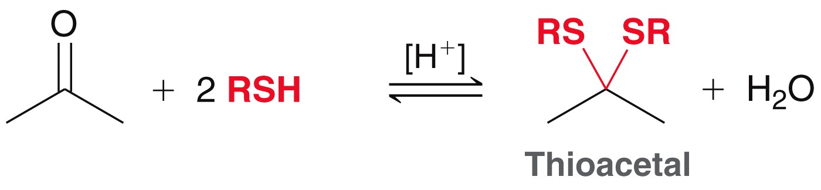
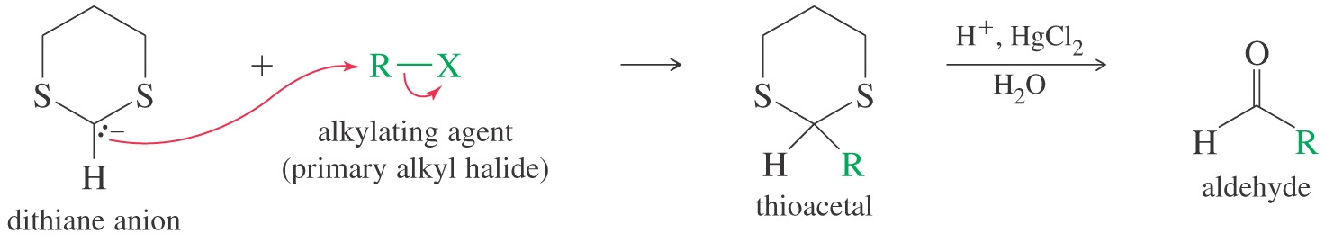
SYNTHESIS OF ALDEHYDES AND KETONES
Synthesis using 1,3-Dithiane
1,3-dithiane is a weak proton acid that can be deprotonated by strong bases such as n-butyllithium. The resulting carbanion is stabilized by the electron-withdrawing effect of two highly polarizable sulfur atoms
Alkylate with primary alkyl halide, then hydrolyze. For ketone, use 2-alkylsubstituted dithiane
Practice 20.29 P. 960

Slide 24
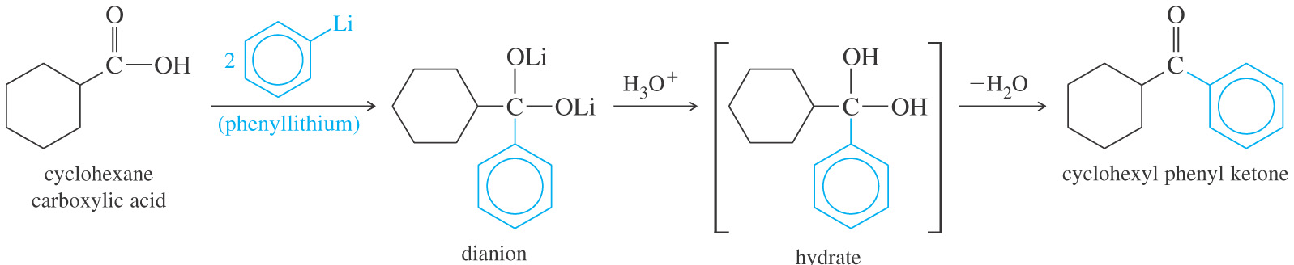
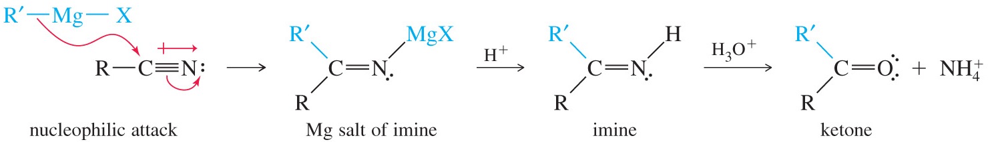
SYNTHESIS OF ALDEHYDES AND KETONES
Synthesis of ketones from Carboxylates
Organolithiums will attack the lithium salts of carboxylate anions to give dianions.
Protonation of the dianion forms the hydrate of a ketone, which quickly loses water to give the ketone
Synthesis of Ketones from Nitriles
A Grignard or organolithium reagent can attack the carbon of the nitrile.
The imine is then hydrolyzed to form a ketone. With LiAl(O-tBu)₃H, it produces an aldehyde

Slide 25
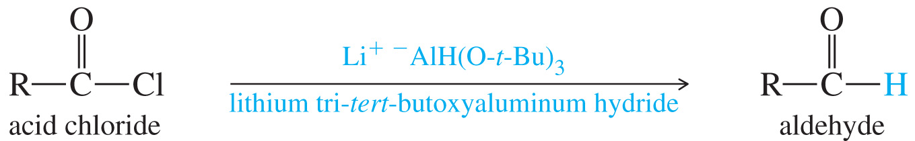
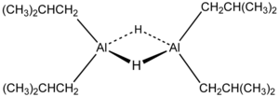
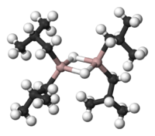
SYNTHESIS OF ALDEHYDES AND KETONES
Synthesis of aldehyde from Acid Chlorides
Lithium aluminum tri(t-butoxy)hydride is a milder reducing agent that reacts faster with acid chlorides than with aldehydes
Diisobutylaluminium hydride
(DIBALH, DIBAL, DIBAL-H or DIBAH
NaBH(OAc)₃ , LiAlH(O-tBu)₃, NaBH₃CN

Slide 26
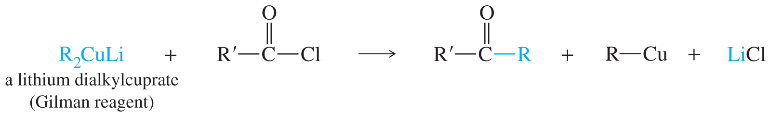
SYNTHESIS OF ALDEHYDES AND KETONES
Synthesis of Ketones from Acid Chlorides
Grignard and organolithium reagents react with acid chloride much like hydride reagents. But they always form alcohols.
To stop at the ketone stage, a weaker organometallic is needed. One that reacts faster with acid chlorides to form ketones is the Gilman reagent (lithium dialkylcuprate)

Slide 27
SYNTHESIS OF ALDEHYDES AND KETONES
Examples: Predict the major product (s) you would expect from the following reactions

Slide 28
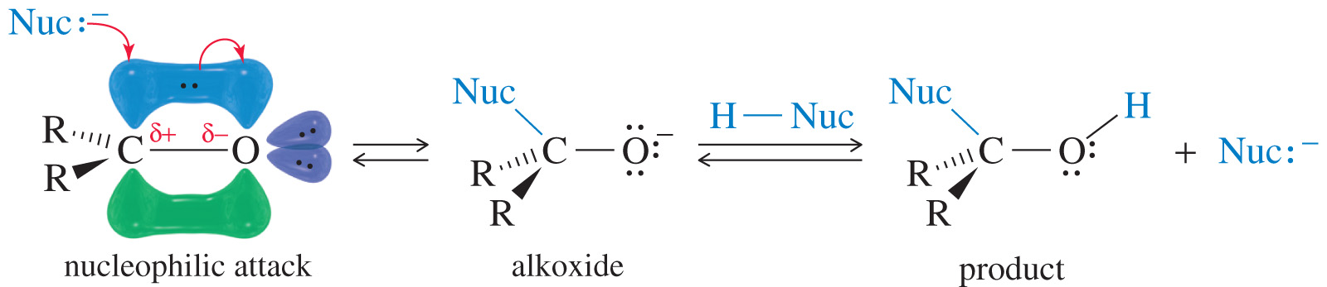
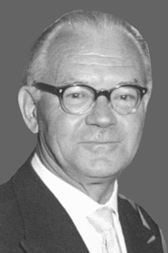
REACTION OF KETONES AND ALDEHYDES
Nucleophilic Addition
A strong nucleophile attacks the carbonyl carbon, forming an alkoxide ion that is then protonated.
A weak nucleophile will attack a carbonyl if it has been protonated, thus increasing its reactivity. Aldehydes are more reactive than ketones.
Georg Wittig (June 16, 1897 – August 26, 1987), German Chemist who developed the synthesis of alkenes using phosphonium yilides, known as Wittig reaction. He shared the 1979 Nobel Prize in Chemistry with Herbert C. Brown.

Slide 29
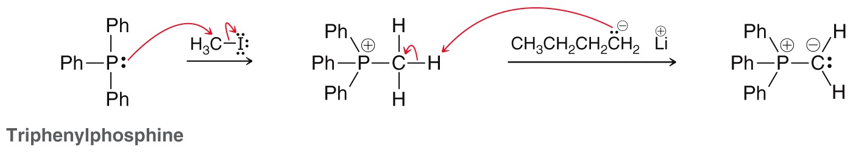
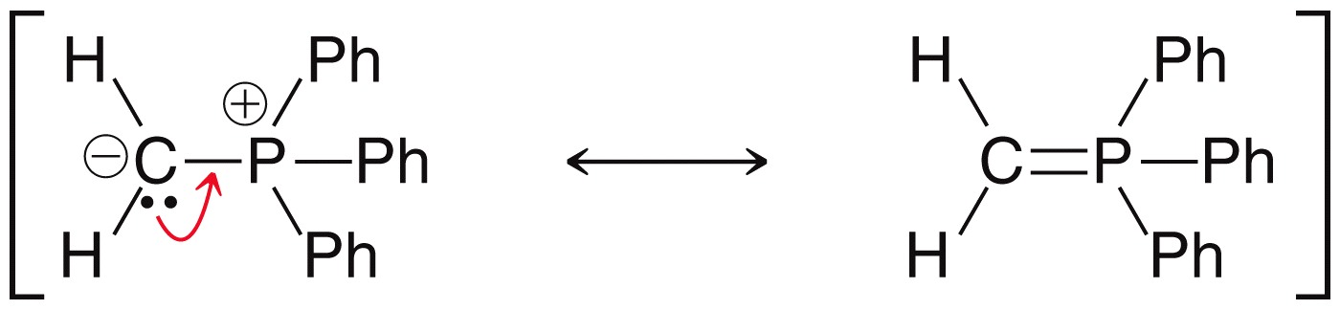
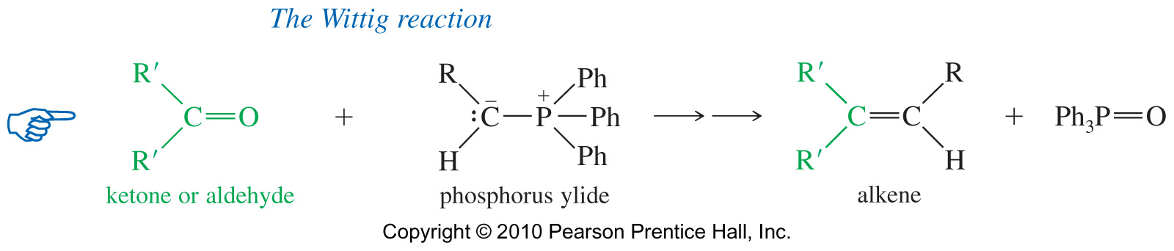
REACTION OF KETONES AND ALDEHYDES
Phosphorus Ylides
Phosphorus ylide is prepared from triphenylphosphine and an unhindered alkyl halide.
Butyllithium then abstracts a hydrogen from the carbon attached to phosphorus.
Wittig Reaction
Nucleophilic addition of phosphorus ylides. Product is alkene. C=O becomes C=C.

Slide 30
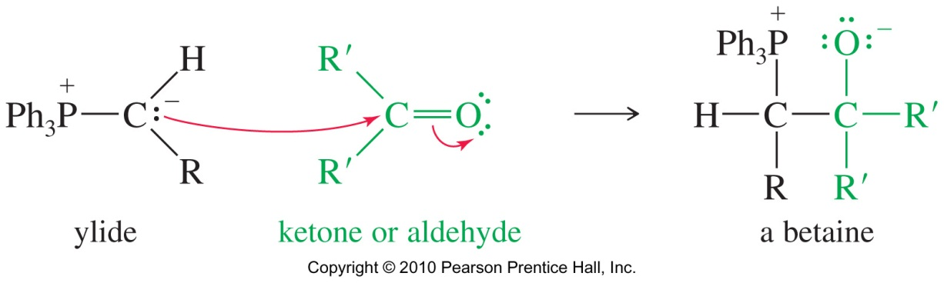
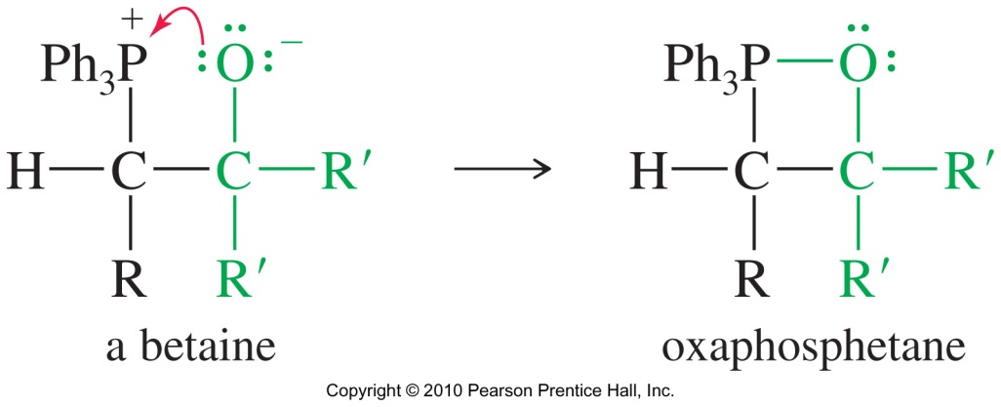
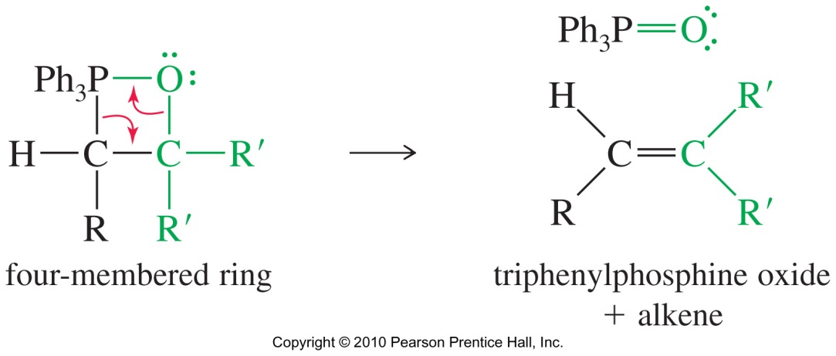
REACTION OF KETONES AND ALDEHYDES
Mechanism for Wittig
Practice 20.37 P. 967

Slide 31
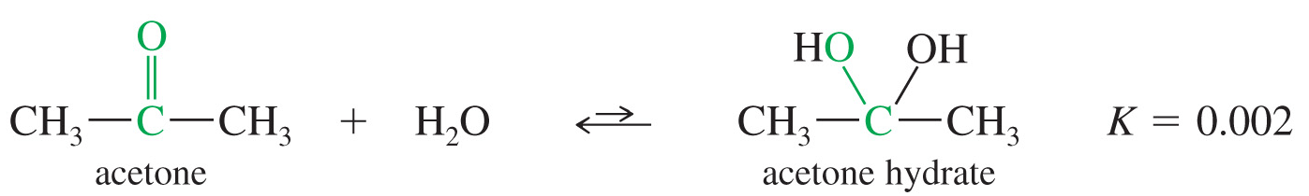
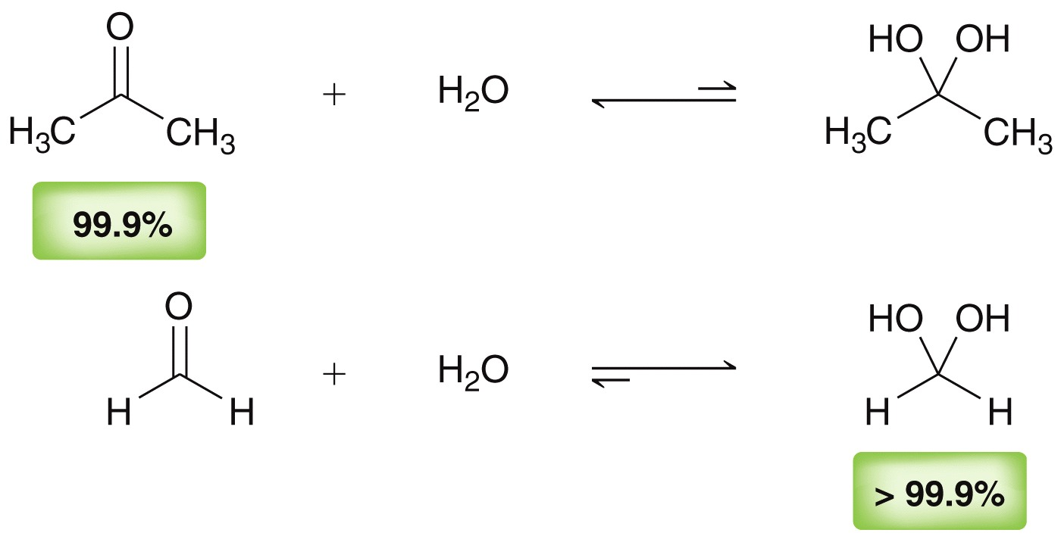
REACTION OF KETONES AND ALDEHYDES
Hydration
In aqueous solutions, ketones and aldehyde are in equilibrium with their hydrate (a geminal diol).
Aldehydes are more electrophilic since they have fewer e--donating alkyl groups
With ketones, the equilibrium favors the unhydrated keto form (carbonyl)
Acetone
Formaldehyde

Slide 32

REACTION OF KETONES AND ALDEHYDES
Formation of acetals
Just as ketones and aldehydes react with water to form hydrates, they also react with alcohols to form acetals.
Mechanism
The reaction must be acid-catalyzed. Adding H⁺ to carbonyl makes it more reactive with weak nucleophile, ROH.
Hemiacetal forms first, then acid-catalyzed loss of water, then addition of second molecule of ROH forms acetal.
All steps are reversible. The loss of a proton from the positively charged intermediate gives a hemiacetal.

Slide 33



REACTION OF KETONES AND ALDEHYDES
Mechanism for Hemiacetal
From Hemiacetal to Acetal

Slide 34


REACTION OF KETONES AND ALDEHYDES
Cyclic Acetals
Addition of a diol produces a cyclic acetal. Sugars commonly exist as acetals or hemiacetals
Addition of a diol produces a cyclic acetal.
The reaction is reversible.
This reaction is used in synthesis to protect carbonyls from reaction

Slide 35


REACTION OF KETONES AND ALDEHYDES
Acetals as Protecting Groups
React with strong nucleophile (base).
Hydrolyze easily in acid; stable in base
Practice 20.8 to 20.12 P. 944-945, 20. 31 P. 961
20.33, 20.34 P. 962
Product favored
Reactant favored

Slide 36

REACTION OF KETONES AND ALDEHYDES
Catalytic Hydrogenation
Like C=C double bond, carbonyl double bonds can be reduced by catalytic hydrogenation. This reaction is widely used in industry.
Raney nickel, finely divided Ni powder saturated with hydrogen gas, Pt and Rh are used as catalysts
Addition of HCN
HCN can react with ketones or aldehydes in the presence of NaCN or KCN in base to form cyanohydrins. HCN is highly toxic
Reactivity formaldehyde > aldehydes > ketones >> bulky ketones

Slide 37


REACTION OF KETONES AND ALDEHYDES
Addition of HCN
Formation of Imines
Under proper conditions, either ammonia or a primary amine reacts with ketone or and aldehyde to form an imine.
This is through Nucleophilic addition of ammonia or primary amine, followed by elimination of water molecule (C=O becomes C=N-R).
Like amines, imines are basic; a substituted imine is called a schiff base.
Practice 20.35, 20.36 P. 964
Problems

Slide 38


REACTION OF KETONES AND ALDEHYDES
This reaction is pH dependent. The loss of water is acid catalyzed, but acid destroys nucleophiles. Optimum pH is around 4.5 NH₃ + H⁺ → NH₄⁺ (not nucleophilic)
Mechanism of Imine Formation
Acid-catalyzed addition of the amine to the carbonyl compound group.
Acid-catalyzed dehydration

Slide 39

REACTION OF KETONES AND ALDEHYDES
Other Condensations
Practice 20.15 to 20.18 P. 950, 20.19, 20.20 P. 952, 20.21 to 20.24 P. 954

Slide 40

REACTION OF KETONES AND ALDEHYDES
Oxidation of Aldehydes
Easily oxidized to carboxylic acids.

Slide 41
REACTION OF KETONES AND ALDEHYDES
Oxidation of Aldehydes: Tollens Test
Add ammonia solution to AgNO₃ solution until precipitate dissolves
Aldehyde reaction forms a silver mirror.
Reduction of ketones and aldehydes
Ketones and aldehydes are commonly reduced by sodium borohydride (NaBH₄) to form secondary and primary alcohols, respectively.
Sodium borohydride, NaBH₄, reduces C=O, but not C=C.
Lithium aluminum hydride, LiAlH₄, much stronger, difficult to handle.
Hydrogen gas with catalyst also reduces the C=C bond

Slide 42

REACTION OF KETONES AND ALDEHYDES
Deoxygenation of Ketones and Aldehydes
A deoxygenation replaces the carbonyl oxygen atom of a ketone or aldehyde with two hydrogen atoms, reducing the carbonyl group past the alcohol stage all the way to a methylene group (Reduction of C=O to CH₂).
Two methods:
Clemmensen reduction if molecule is stable in hot acid.
Wolff-Kishner reduction if molecule is stable in very strong base

Slide 43

REACTION OF KETONES AND ALDEHYDES
Deoxygenation: Wolff-Kisher Reduction
Compounds that cannot survive treatment with hot acid can be deoxygenated using Wolff-Kischner reduction.
The Ketone or aldehyde is converted to its hydrazone, which is heated with strong base like KOH or potassium t-butoxide, using a high-boiling solvent (ethylene glycol, diethylene glycol, or DMSO).
A molecule of nitrogen is lost in the last steps of the reaction

Slide 44

REACTION OF KETONES AND ALDEHYDES
Wolff-Kisher Reduction – Mechanism

Slide 45
REACTION OF KETONES AND ALDEHYDES
Deoxygenation: Clemmensen Reduction
This reaction commonly converts acylbenzenes to alkylbenzenes.

Slide 46

REACTION OF KETONES AND ALDEHYDES
Baeyer-Villiger reaction
An oxygen is inserted between a carbonyl carbon and neighboring group. If the carbonyl is asymmetrical, use the following chart to determine which group migrates most readily
Practice 20.40 P.969

Slide 47
REACTION OF KETONES AND ALDEHYDES
Examples: Predict the major product (s) you would expect from the following reactions
Practice 20.41, 20.42 P. 935
Problems 20.50 to 20.75 P. 979 to 981

